Slide 1

Luxury Used Cars Analysis
Team members:
Hazim Bukhari
Amena AlSamah
Rashed AlHilal

Slide 2
Business Problem.
A new luxury used cars dealership is opening.
Currently used cars pricing is done manually.

Slide 3
Why are we doing this?
Save Time.
Cost Efficient.
More Accurate.

Slide 4
How are we going to do it?
Collect Data from cars.com (WHY?).
Extract insight.
Build multiple ML models.
Choose the best model.

Slide 5
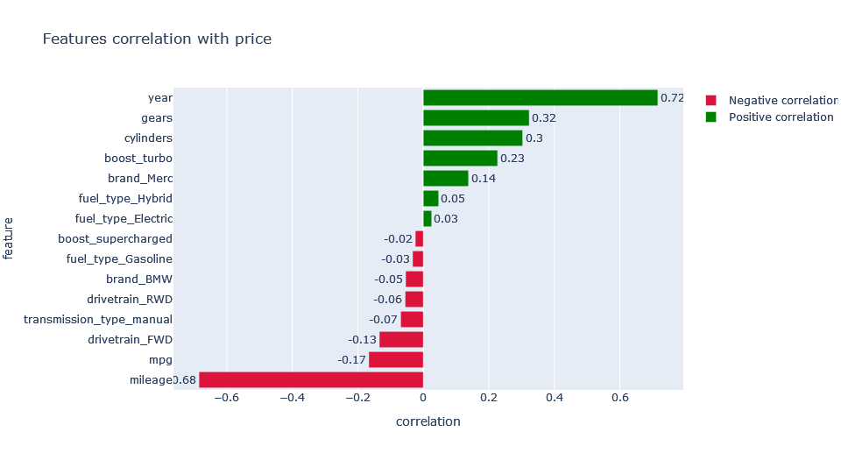
Findings

Slide 6
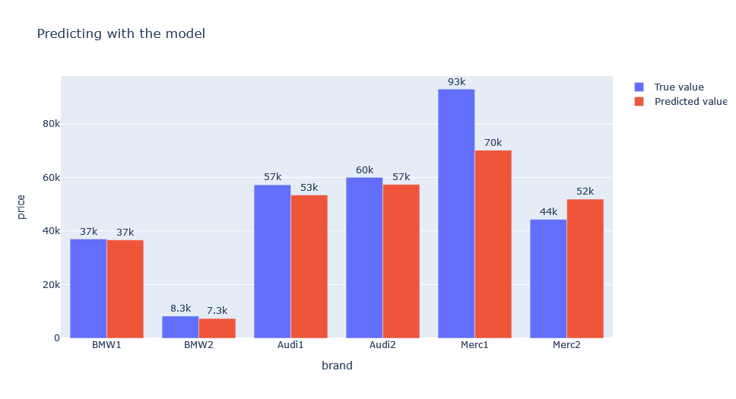
Predicting

Slide 7
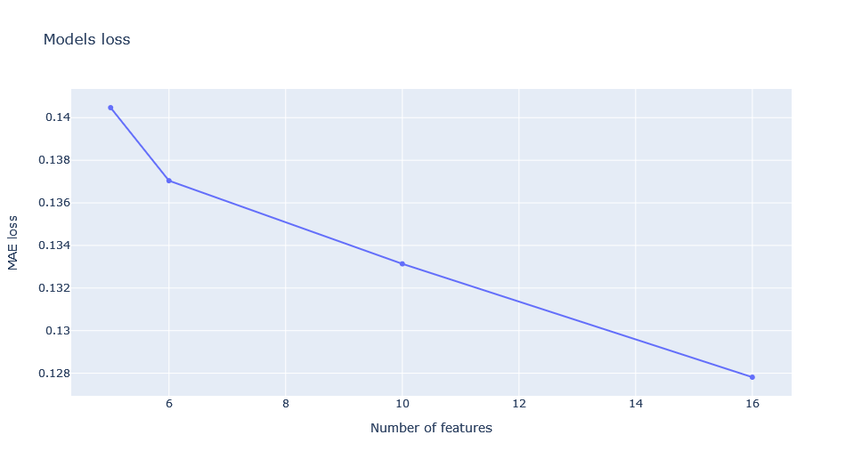
Findings Cont.

Slide 8
Conclusion
We observed that the most important factors in predicting the price are:
Year.
Cylinders.
Is it Electric.
MPG.
Mileage.

Slide 9
Recommendation
Some additional features could be added like:
Auto cruse control.
Self parking.
Auto pilot.

Slide 10

Thank You

